Slide 1

IRIS CLASSIFICATION
EFREI 2019-2020
APPLIED STATISTICS
ROBIN GILLES-SEIMANDI JULIETTE

Slide 2

Summary
I. Dataset presentation
II. link between variables
III. How to predict iris species
Applied statistics project 2019

Slide 3
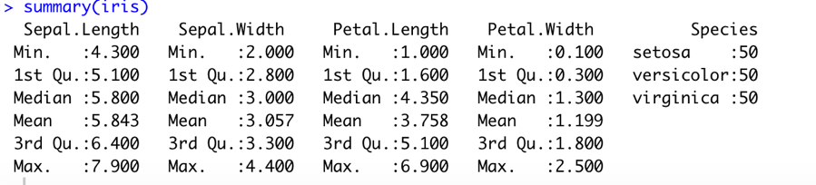
Iris dataset summary
TREE SPECIES EQUITABLY DISTRIBUTED
4 NUMERIC CRITERIA

Slide 4
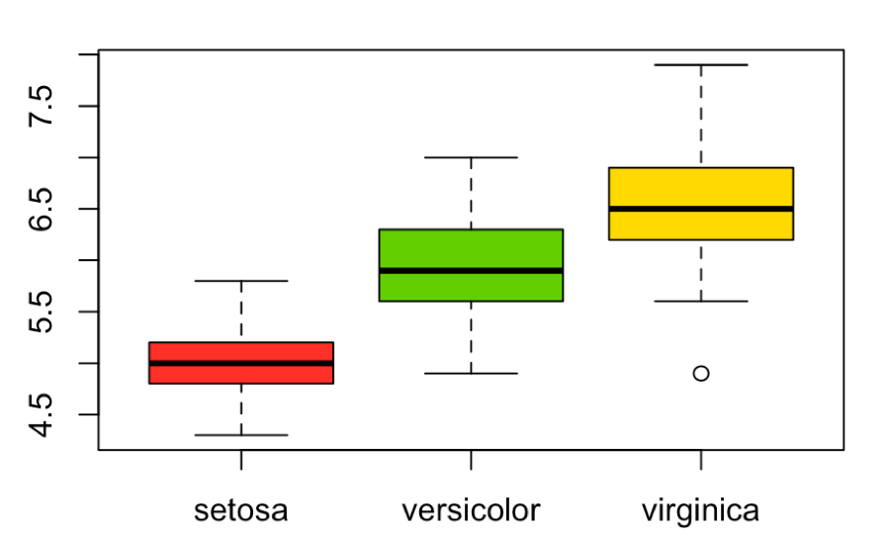
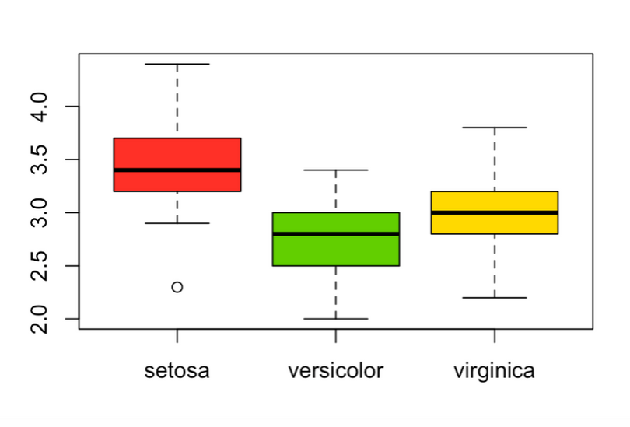
CRITERIA FOR SEPALE
IRIS SEPAL LENGHT
IRIS SEPAL WIDTH
Repartition by species
Repartition by species

Slide 5
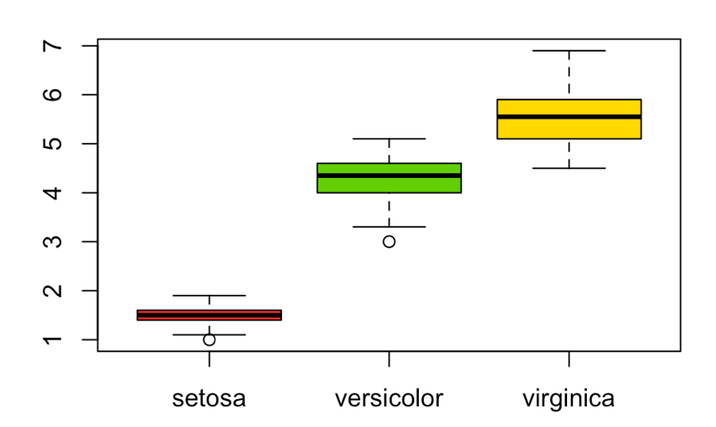
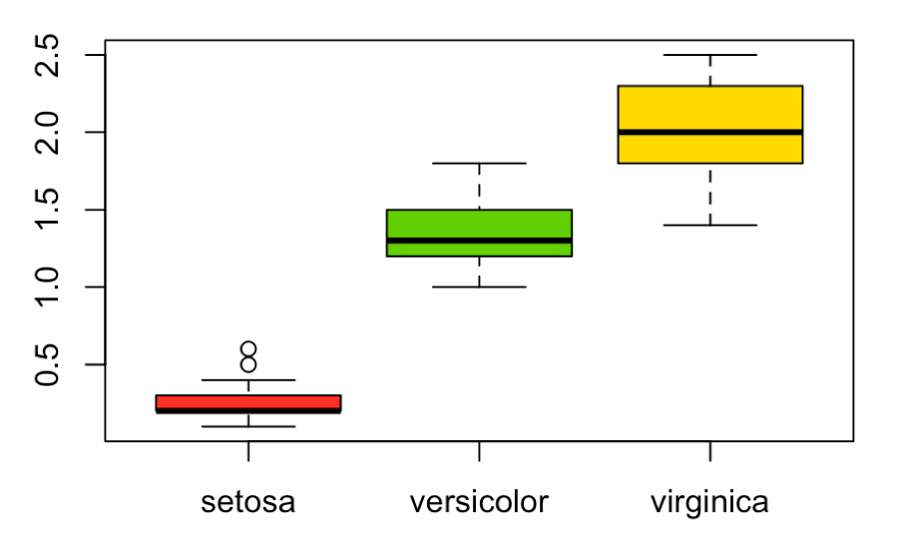
CRITERIA FOR PETAL
IRIS PETAL LENGHT
IRIS PETAL WIDTH
Repartition by species
Repartition by species
Notes:
à dire que les 4 critères sont relevants mais peut plus visible sur petal lenght et petal width, du coup on peut se demander si on peut créer in model pour identifier une iris selon ces critères

Slide 6
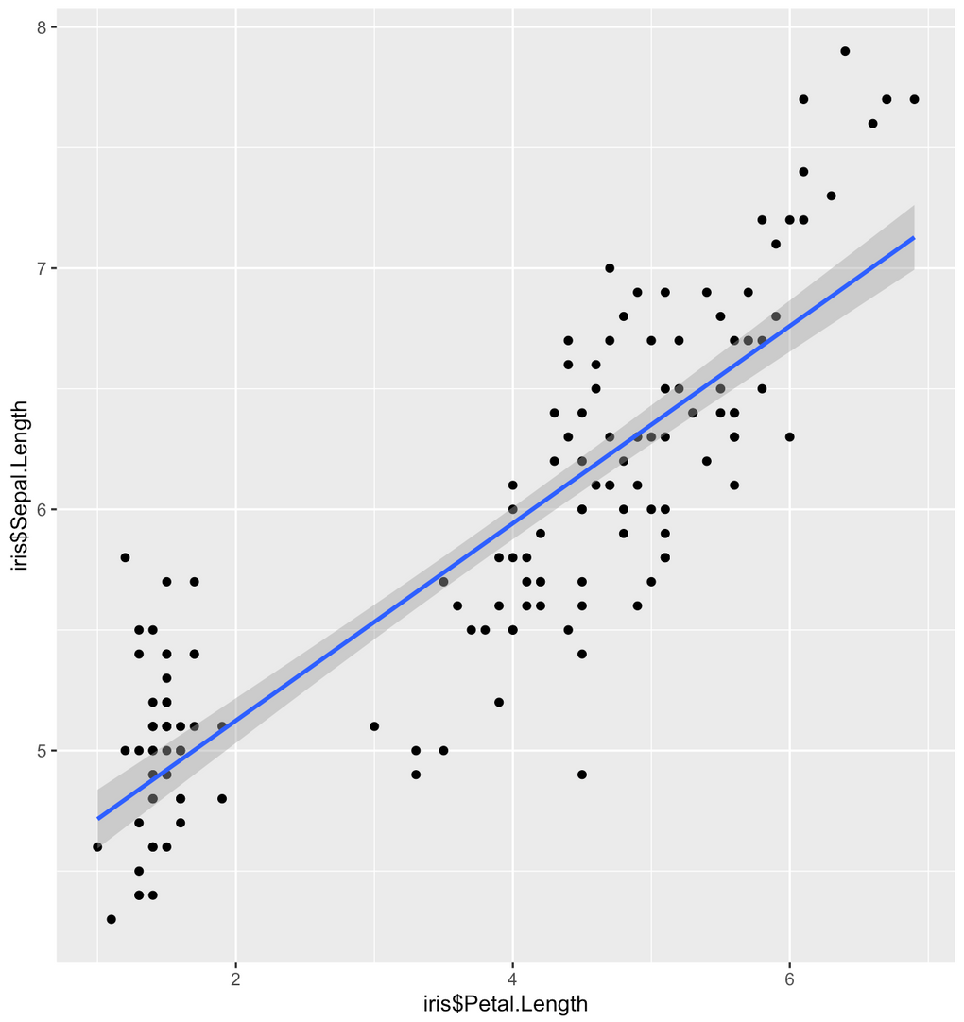
Iris Sepal lenght according to Petal Lenght
Link between criteria
Regression linear allows us to find correlation between only two criteria.
We better find clustering than linear correlation

Slide 7
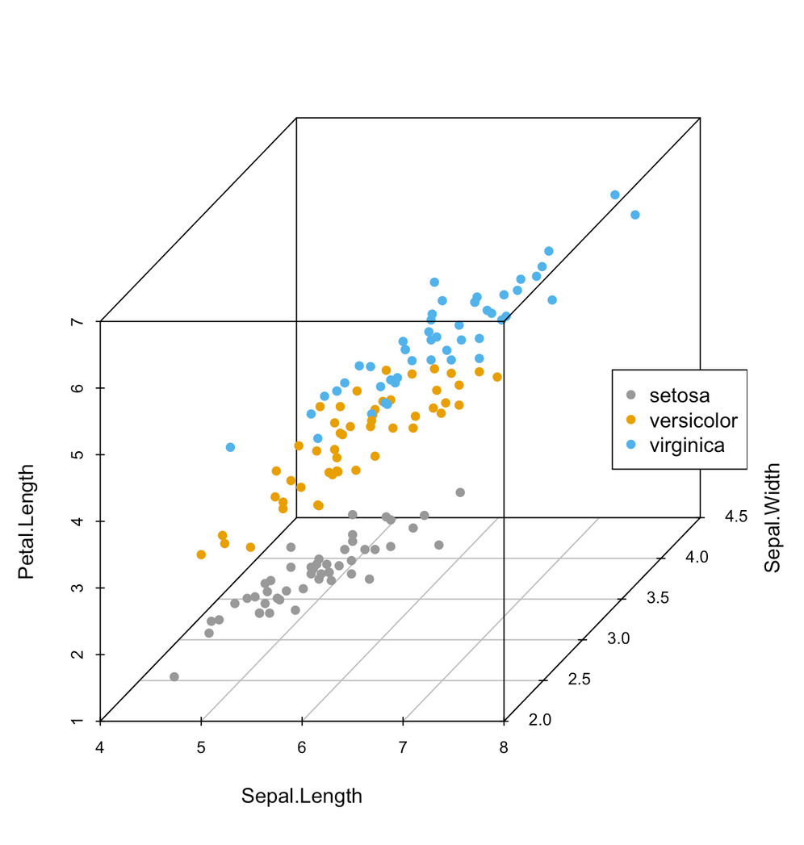
3D plot of link between Sepal lenght and width and Petal lenght
3D identification
Link between those tree criteria that allows us to clearly identify the tree species

Slide 8
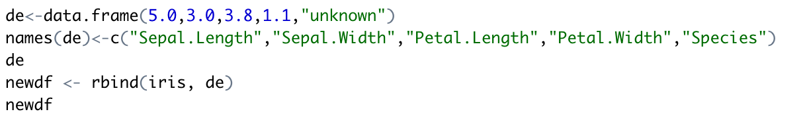
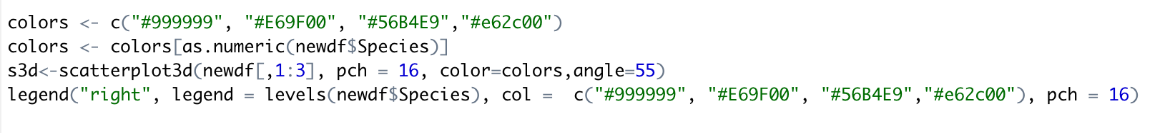
How to predict iris species
Example
Create a new dataset with an add row at the end with an unknown species
Plot the correlation but with a special color for the unknown species

Slide 9
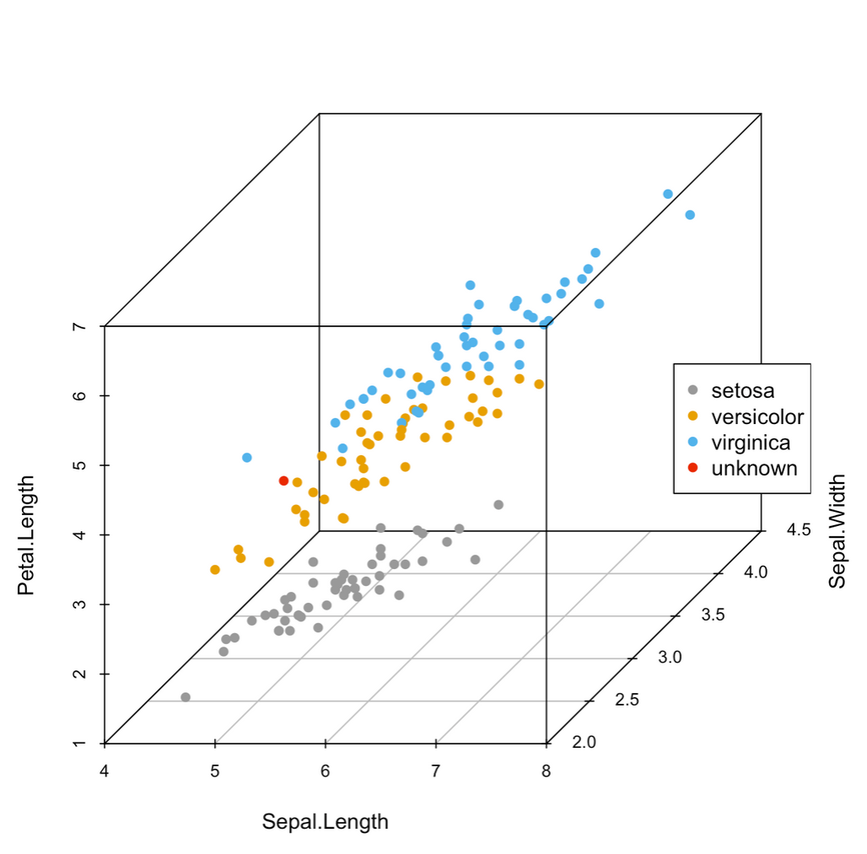
3D plot with unknown point in red
3D identification
we can identify at which cluster it seems to be a part of (Versicolor)
We can use the last criterion non use in our 3D model to confirm our theory

Slide 10
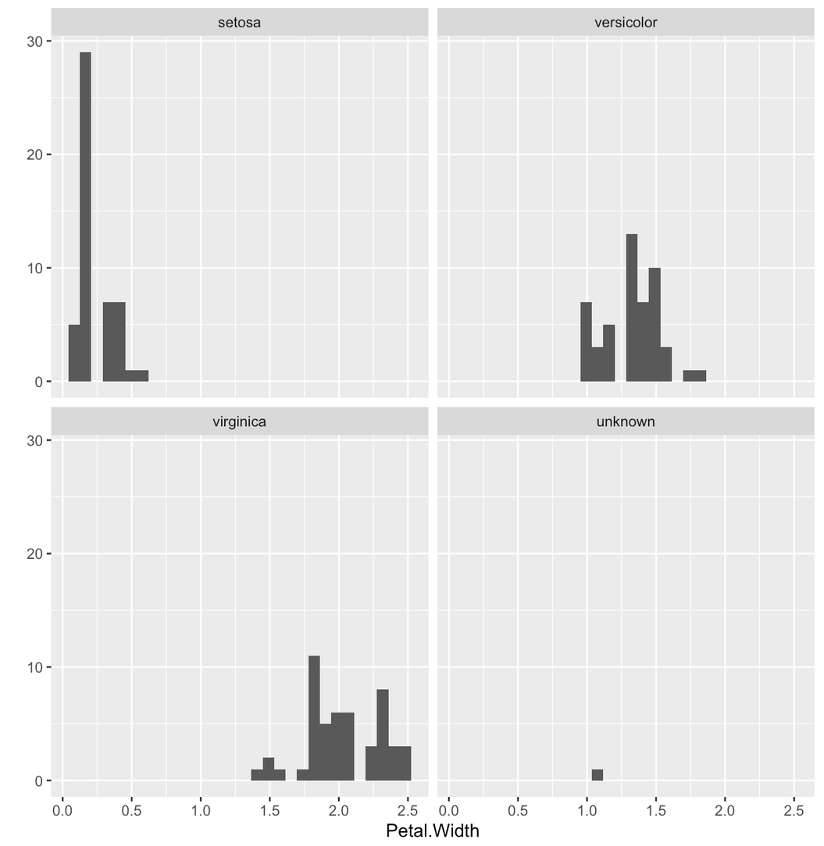
Histogram of Petal width by species
Model validation
We saw earlier that Petal Width is a relevant criteria so we want to see in which Petal Width interval our unknown species is

Slide 11

conclusion
Thank you for your attention

